Slide 1


TIVIDY
Generic Workflow Management System
COS 214 FINAL PROJECT · 2026
Lindokuhle Skosana
u24891968
Kristy Heesen
u24702341
LM Kabongo
25030338
Joshua Peter
23626527
Musa Msibi
25098022
Notes:
Speaker: [assign]
Section time: 0-4 min: the engine and both industries
Welcome the client, introduce the team, and say we will show a short overview and then run the real system live.

Slide 2





What you asked for, what we built
OVERVIEW
YOU ASKED FOR
WHAT WE BUILT
One engine for any industry
Built once. Each industry just plugs in its own steps.
Two different industries
University complaints and hospital admissions, side by side.
Every case on its own
Cases are kept separate, so one never affects another.
See where things stand
Check progress and the full history of any case.
Mistakes don’t break things
Wrong actions are stopped. Problems go to the right person.
Notes:
Speaker: [assign]
Section time: 0-4 min: the engine and both industries
Confirm each concern against the brief before presenting; edit the rows if the brief differs.
Walk down the five rows: one engine, two industries, independent cases, visible progress, safe handling of mistakes.

Slide 3



Two industries, one engine
OVERVIEW
University complaints
From a student’s complaint to the final outcome
THE TIVIDY ENGINE
The same for both
Hospital admission & treatment
From a patient walking in to going home
Where each case is
Who does what
Escalation, alerts and history
Only the steps and the people change. The engine stays the same.
Notes:
Speaker: [assign]
Section time: 0-4 min: the engine and both industries
Both industries run on exactly the same engine. Only the process definition, roles, rules and notices change between them.

Slide 4
The engine in one picture
OVERVIEW
Escalate
5
Submitted
1
Active
2
In Progress
3
Resolved
4
4
Closed
1
2
3
4
5
Accepted
Someone checks the case before any work starts.
Work begins
Progress shows up from the very first step.
All work done
A case is only resolved once everything is finished.
Withdrawn or rejected
The case ends without being resolved.
Escalated
The case stays In Progress and moves up to the next decision maker.
Notes:
Speaker: [assign]
Section time: 0-4 min: the engine and both industries
Trace one case left to right. Check every caption against the final state diagram before presenting.
Message: every case follows the same lifecycle in both industries, and escalation never changes the stage, only who decides.

Slide 5
Two Industries
01
University complaint handling · Hospital patient admission & treatment
Notes:
Section time: 0-4 min: the engine and both industries
Two distinct industries, one reusable engine. Explain the process, participants, input data and expected result of each.

Slide 6







University Complaint Workflow
01 · INDUSTRY 1 · EDUCATION
1
Submit complaint
2
Review & classify
3
Assign to department
4
Investigate
5
Decide or escalate
6
Resolve or close
PARTICIPANTS AND ROLES
POSSIBLE OUTCOMES
Student submits the complaint, receives the outcome
Resolved
Student accepts the outcome
Administrator reviews, classifies and routes
Closed: retracted
Student withdraws the complaint
Staff member / lecturer investigates and tries to resolve
Department head handles escalated or higher-approval cases
Closed: appeal denied
Final appeal is denied
Faculty representative final escalation level
Input data: complaint type, description, student details
Notes:
Section time: 0-4 min: the engine and both industries
A student submits a complaint; an administrator reviews and routes it; a staff member investigates; if it cannot be resolved it is escalated; the student accepts or appeals. Final outcomes are Resolved or Closed.

Slide 7



Hospital Patient Admission & Treatment
01 · INDUSTRY 2 · HEALTHCARE
1
Register patient
2
Triage
3
Admit & assign
4
Diagnose
5
Treat
6
Discharge or close
PARTICIPANTS AND ROLES
POSSIBLE OUTCOMES
Patient arrives and receives care
Resolved: discharged
Treatment complete
Admissions clerk registers and admits the patient
Closed: withdrawn
Patient leaves or withdraws
Triage nurse assesses urgency
Doctor diagnoses and treats
Closed: referred
Case continues elsewhere
Specialist handles escalated cases, final decisions
Input data: patient details, symptoms, urgency
Notes:
Section time: 0-4 min: the engine and both industries
DRAFT CONTENT - confirm against the implemented Hospital workflow. A patient is registered, triaged, admitted and assigned, diagnosed and treated, then discharged or the case is closed.

Slide 8
Live Demonstration
02
Interactive C++11 text interface running both industries
Notes:
Section time: 4-12 min: industry 1 live (University)
Minutes 4-20. 4-12 industry 1 with decisions and an exception. 12-20 industry 2 on the same engine. Bring a reliable local setup.

Slide 9
Demo run-through
02 · LIVE DEMONSTRATION
INDUSTRY 1: UNIVERSITY COMPLAINT
INDUSTRY 2: HOSPITAL ADMISSION
1
Start an independent complaint instance
1
Register a patient and start an instance
2
Inspect available work and assignments
2
Triage and mark urgent cases as priority
3
Administrator reviews, classifies and routes
3
Admit and assign a doctor and bed
4
Staff cannot resolve: escalate up the chain
4
Complication: escalate to the specialist
5
Student accepts (Resolved) or appeals
5
Discharge (Resolved) or close the case
6
View state changes and history
6
View state changes and history
In both runs: include one invalid action (rejected by the current state) and be ready for unscripted interactions.
Notes:
Section time: 4-12 min: industry 1 live (University)
Show one completion path and one exception path per industry, including an invalid action rejected by the State pattern.

Slide 10
University: work, decisions and exceptions
02 · LIVE DEMONSTRATION · EDUCATION
WORK ITEMS
DECISIONS & ROUTING
EXCEPTIONS
Submit complaint
Review complaint
Identify complaint type
Assign complaint
Investigate complaint
Make decision
Escalate complaint
Review appeal
Resolve complaint
Close complaint
What type of complaint is it?
Which department receives it?
Can the staff member resolve it?
Should it be escalated?
Does the student accept the outcome?
Should an appeal be created?
Insufficient information from the student
Complaint sent to the wrong department
Cannot be resolved at the current level
Email notification fails
Student withdraws the complaint
Student appeals the decision
Dependencies: submit → review → assign → investigate. External system: email notices for confirmation, assignment, escalation and resolution.
Notes:
Section time: 4-12 min: industry 1 live (University)
Dependencies: complaint must be submitted before review, reviewed before assignment, assigned before investigation. An external email system sends confirmation, assignment, escalation and resolution notices.

Slide 11
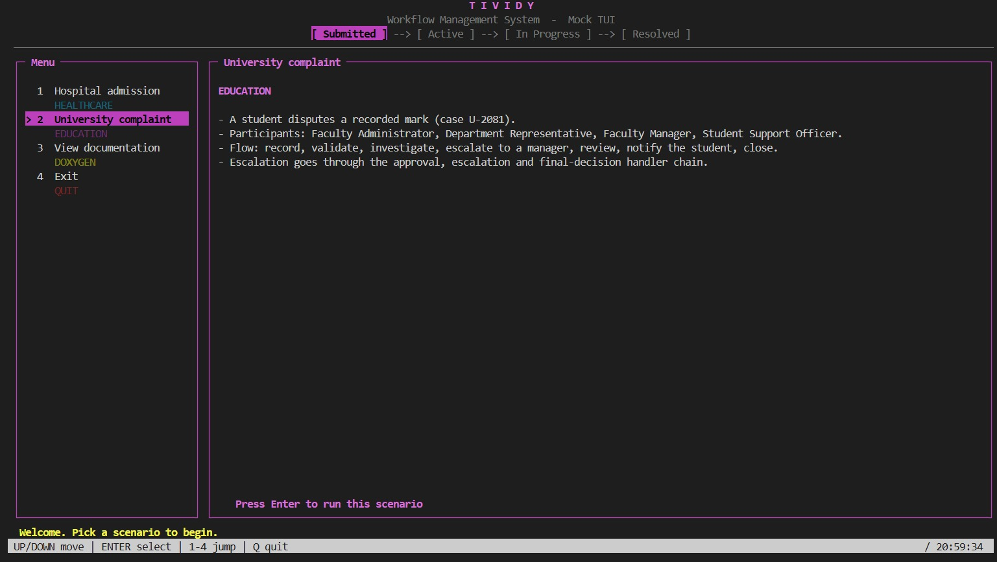
Live demo: University complaint
02 · LIVE DEMONSTRATION
We start a case and take it from start to finish.
Notes:
Speaker: [assign]
Section time: 4-12 min: industry 1 live (University)
Run both scenarios on the real TUI: start a case, show available work, complete items, show a decision and an exception, show the history.
Then invite the client to prompt changes: add or cancel a work item, change who does it or its priority, start a second case, try an invalid action. Rehearse these in advance. Screenshots are an emergency fallback only.

Slide 12
Hospital: work, decisions and exceptions
02 · LIVE DEMONSTRATION · HEALTHCARE
WORK ITEMS
DECISIONS & ROUTING
EXCEPTIONS
Register patient
Capture patient details
Triage assessment
Assign doctor and bed
Diagnose
Treat
Review treatment plan
Escalate to specialist
Discharge patient
Close case
Is the case urgent?
Admit or treat as outpatient?
Which doctor and bed are available?
Can the doctor treat, or escalate?
Is the treatment plan approved?
Is the patient fit for discharge?
Missing patient information
No bed available
Complication during treatment
Specialist unavailable: next level
Patient leaves against advice
Notification fails
Dependencies: register → triage → admit → diagnose → treat. External system: ward and patient notifications through the same adapter.
Notes:
Section time: 12-20 min: industry 2 live (Hospital) and "your turn"
DRAFT CONTENT - confirm against the implemented Hospital workflow before presenting.

Slide 13
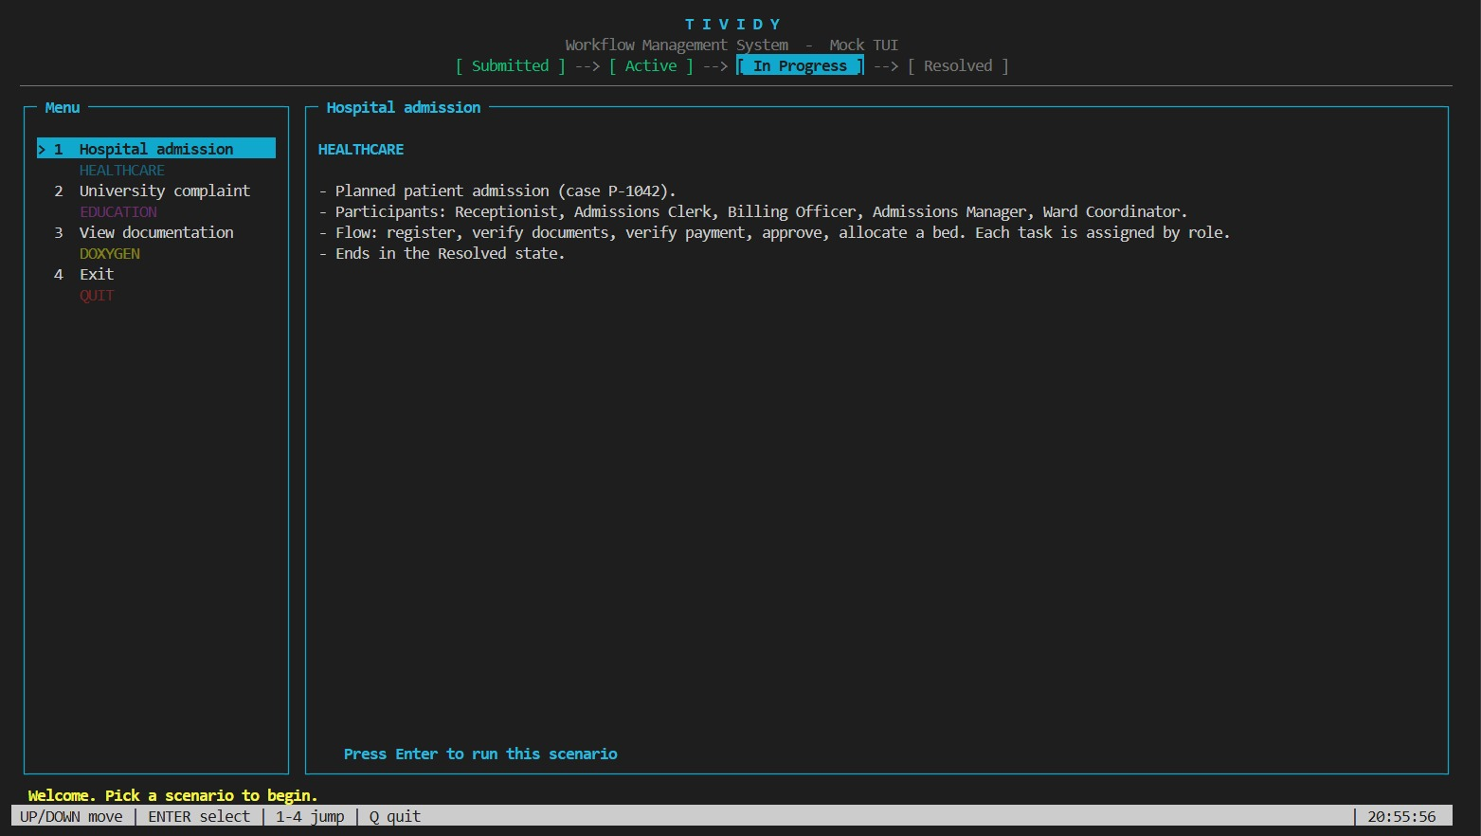
Live demo: Hospital admission
02 · LIVE DEMONSTRATION
Same engine, different process.
Notes:
Speaker: [assign]
Section time: 12-20 min: industry 2 live (Hospital) and "your turn"
Run both scenarios on the real TUI: start a case, show available work, complete items, show a decision and an exception, show the history.
Then invite the client to prompt changes: add or cancel a work item, change who does it or its priority, start a second case, try an invalid action. Rehearse these in advance. Screenshots are an emergency fallback only.

Slide 14
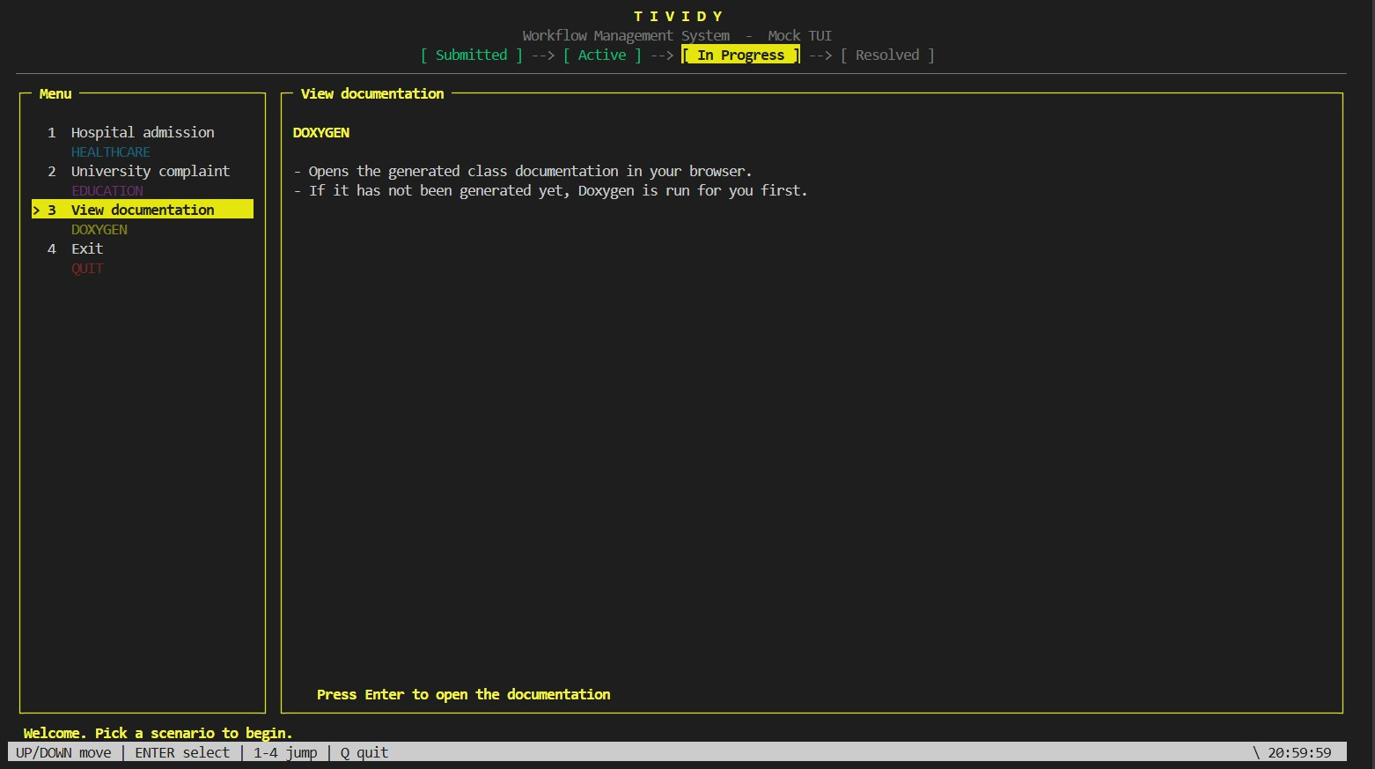
Live demo: Your turn
02 · LIVE DEMONSTRATION
Tell us what to change and we’ll do it live.
Notes:
Speaker: [assign]
Section time: 12-20 min: industry 2 live (Hospital) and "your turn"
Run both scenarios on the real TUI: start a case, show available work, complete items, show a decision and an exception, show the history.
Then invite the client to prompt changes: add or cancel a work item, change who does it or its priority, start a second case, try an invalid action. Rehearse these in advance. Screenshots are an emergency fallback only.

Slide 15
Design & Engineering
03
Patterns, tests and automation behind the demo
Notes:
Section time: 20-25 min: patterns, diagrams, tests and engineering practice (keep the engineering slides under 3 minutes in total)
Be ready to show the build, the test run, repository history and any CI/CD or Docker bonus work.

Slide 16
Same engine, different configuration
03 · DESIGN & ENGINEERING
Responsibility | University complaint | Hospital admission | Generic engine classes (unchanged)
Workflow definition | Built for complaints | Built for admissions | WorkflowBuilder, WorkflowDirector, WorkflowDefinition
Structure of work | Stages, work items, appeal sub-process | Stages, work items, treatment sub-process | WorkflowComponent, WorkItem, WorkflowStage, SubProcess
Assignment | Role-based by department | Workload-based by availability | AssignmentStrategy and its concrete strategies
Escalation chain | Staff, department head, faculty rep | Nurse, doctor, specialist | Handler, EscalationHandler, ApprovalHandler, FinalDecisionHandler
Notifications | Email to student and staff | Alerts to ward and patient | NotificationService, EmailAdapter
Lifecycle & history | Submitted to Resolved or Closed | Submitted to Resolved or Closed | WorkflowInstance, WorkflowState, observers, WorkflowHistory
Notes:
Section time: 20-25 min: patterns, diagrams, tests and engineering practice (keep the engineering slides under 3 minutes in total)
Both scenarios reuse the generic engine classes without modification. Confirm the hospital column (assignment strategy, chain order) against your implementation.

Slide 17
Design patterns used
03 · DESIGN & ENGINEERING
Pattern | Category | What it does for us
Builder | Creational | Puts each industry’s workflow together step by step
Prototype | Creational | Every new case gets its own copy of the template, so cases never share work
Composite | Structural | Tasks, stages and sub-processes are treated the same way
Decorator | Structural | Adds priority handling to a task without changing it
Adapter | Structural | Lets us send email without depending on one email service
Facade | Structural | One simple front door to the whole engine
State | Behavioural | A case behaves according to where it is in its life
Strategy | Behavioural | Who gets the work can be decided by role or by workload
Chain of Responsibility | Behavioural | Escalation moves up the decision makers until one can act
Command | Behavioural | Every action is a saved request that can be recorded or undone
Memento | Behavioural | Takes a snapshot so a step can be rolled back
Observer | Behavioural | History and notifications react whenever a case changes
Notes:
Section time: 20-25 min: patterns, diagrams, tests and engineering practice (keep the engineering slides under 3 minutes in total)
Prototype is the second creational pattern. Participants (from the class diagram): Prototype = WorkflowComponent, ConcretePrototypes = WorkItem, WorkflowStage, SubProcess, PriorityDecorator, Client = WorkflowDefinition / WorkflowInstance. Confirm the exact creation path with the code.

Slide 18
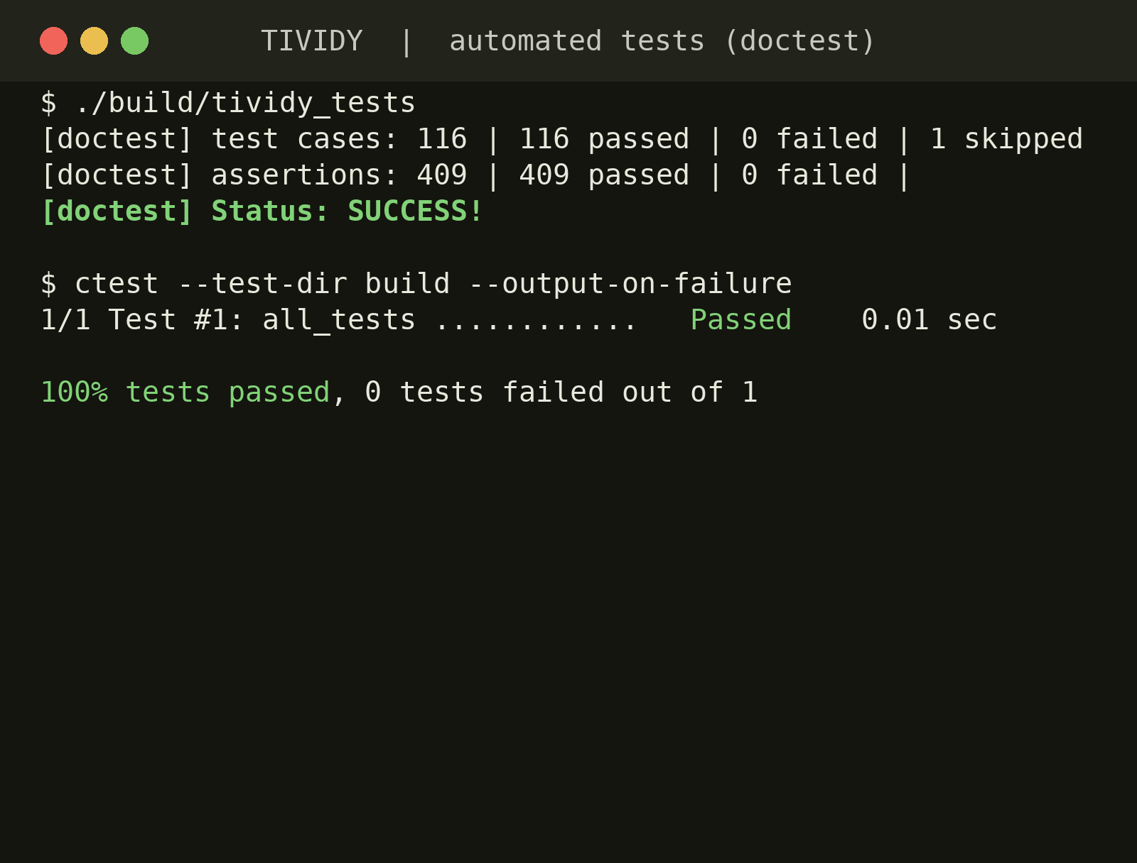

Testing: we catch problems first
03 · DESIGN & ENGINEERING
We test as we go
Automated checks using doctest
Why it matters
We find problems before you do
What gets checked
Case steps, hand-offs, separate cases and wrong actions
Notes:
Speaker: [assign]
Section time: 20-25 min: patterns, diagrams, tests and engineering practice (keep the engineering slides under 3 minutes in total)
Capture a screenshot of a passing run (see the summary line: test cases passed, 0 failed).

Slide 19

Automated testing
03 · DESIGN & ENGINEERING
TEST SUITE
117
tests written
116
passing
Framework: doctest
State transitions
Valid transitions succeed; the lifecycle reaches Resolved or Closed.
Routing & assignment
Role-based and workload-based strategies pick the right participant.
Instance isolation
Changing one instance never affects another from the same definition.
Invalid operations
Actions not allowed in the current state are rejected cleanly.
Notes:
Section time: 20-25 min: patterns, diagrams, tests and engineering practice (keep the engineering slides under 3 minutes in total)
Fill in the framework, test counts and the test command. Every member must have contributed tests. Manual tests and standalone assert programs are not sufficient.

Slide 20
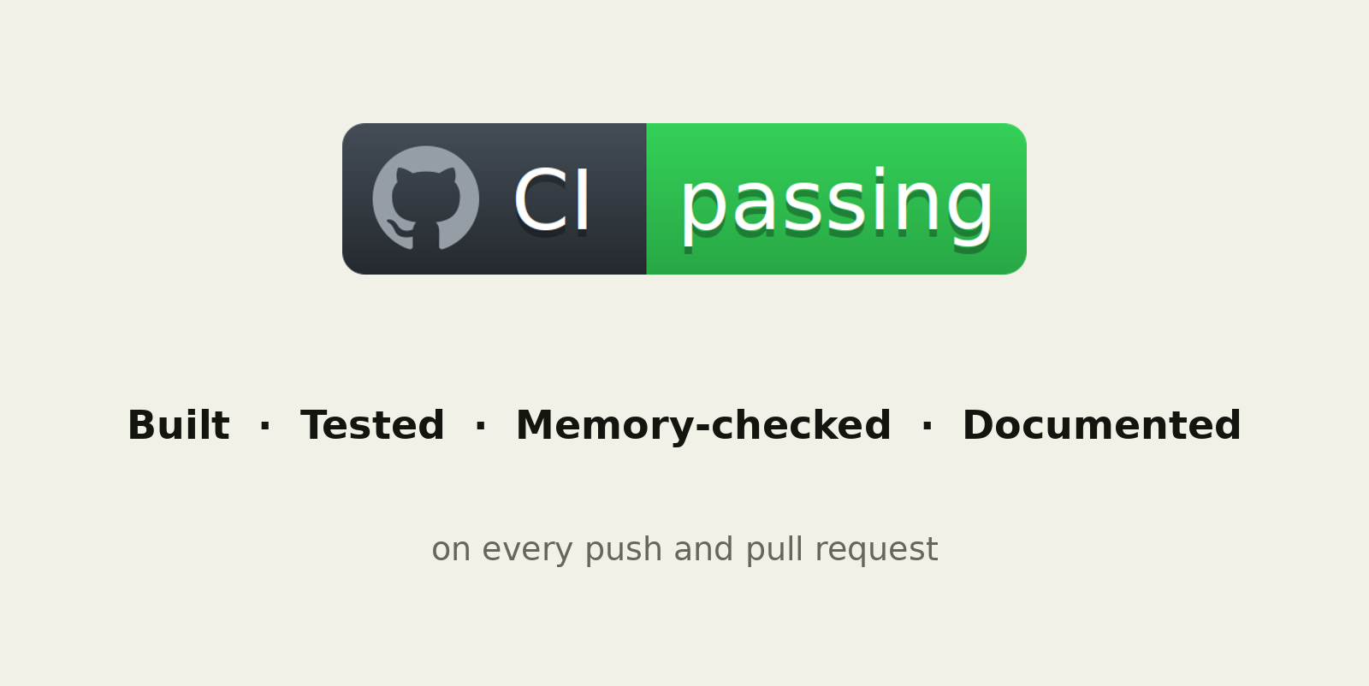


Every change is checked automatically
03 · DESIGN & ENGINEERING
Checked automatically
GitHub Actions runs every time we save our work
Built, tested, memory-checked
Mistakes are caught before they reach the main version
Insert image here
Screenshot: Docker run (remove if not done)
Docker
Runs the same way on any computer
Notes:
Speaker: [assign]
Section time: 20-25 min: patterns, diagrams, tests and engineering practice (keep the engineering slides under 3 minutes in total)
GitHub Actions builds the project, runs the tests and memory-checks it on every push.
If Docker is not done, delete the Docker bullet and the small screenshot placeholder.

Slide 21


Engineering practice and evidence
03 · DESIGN & ENGINEERING
GitHub workflow
Documentation
Repository: github.com/Kristy2005/TIVIDY-Prac6
Commits: 13 to 58 per member on main (minimum 10)
Closed pull requests: 61 merged (minimum 3)
Doxygen comments on significant classes
README: dependencies, build, run, test
docs/ and UML exports in the repository
Build & run
Optional bonus
Build: make build
Run: ./build/tividy
Test: make test
GitHub Actions: build, tests, Valgrind, Doxygen
Dockerised on Ubuntu 24.04 (Dockerfile in repo)
Notes:
Section time: 20-25 min: patterns, diagrams, tests and engineering practice (keep the engineering slides under 3 minutes in total)
Compulsory: at least 10 meaningful commits per member, at least three closed pull requests, Doxygen documentation, README with build/run/test for both industries. Bonus (optional): CI/CD, Docker.

Slide 22
Team contributions
03 · DESIGN & ENGINEERING
Member | Student no. | Practical 6 contribution | Final project contribution
Lindokuhle Skosana | u24891968 | Activity diagrams, design patterns | [add contribution]
Kristy Heesen | u24702341 | Scope and scenario, class diagram, design patterns | [add contribution]
LM Kabongo | 25030338 | Research, sequence and state diagrams | [add contribution]
Joshua Peter | 23626527 | Research, activity diagrams | [add contribution]
Musa Msibi | 25098022 | Design patterns, escalation sequence diagram | [add contribution]
Notes:
Section time: 20-25 min: patterns, diagrams, tests and engineering practice (keep the engineering slides under 3 minutes in total)
Practical 6 contributions are taken from the group document. Complete the final project column for each member.

Slide 23
Questions
Thank you
github.com/Kristy2005/TIVIDY-Prac6
Lindokuhle Skosana
u24891968
Kristy Heesen
u24702341
LM Kabongo
25030338
Joshua Peter
23626527
Musa Msibi
25098022
Notes:
Section time: 25-30 min: questions and code inspection
Minutes 25-30: questions, code inspection and individual understanding. Every member should be able to explain the whole design.

Slide 24
Appendix
APPENDIX
Only if you’d like to see more: diagrams, patterns and tests
Notes:
Section time: Appendix: only if asked
Not presented. Use only if the client or markers ask for the design detail.

Slide 25
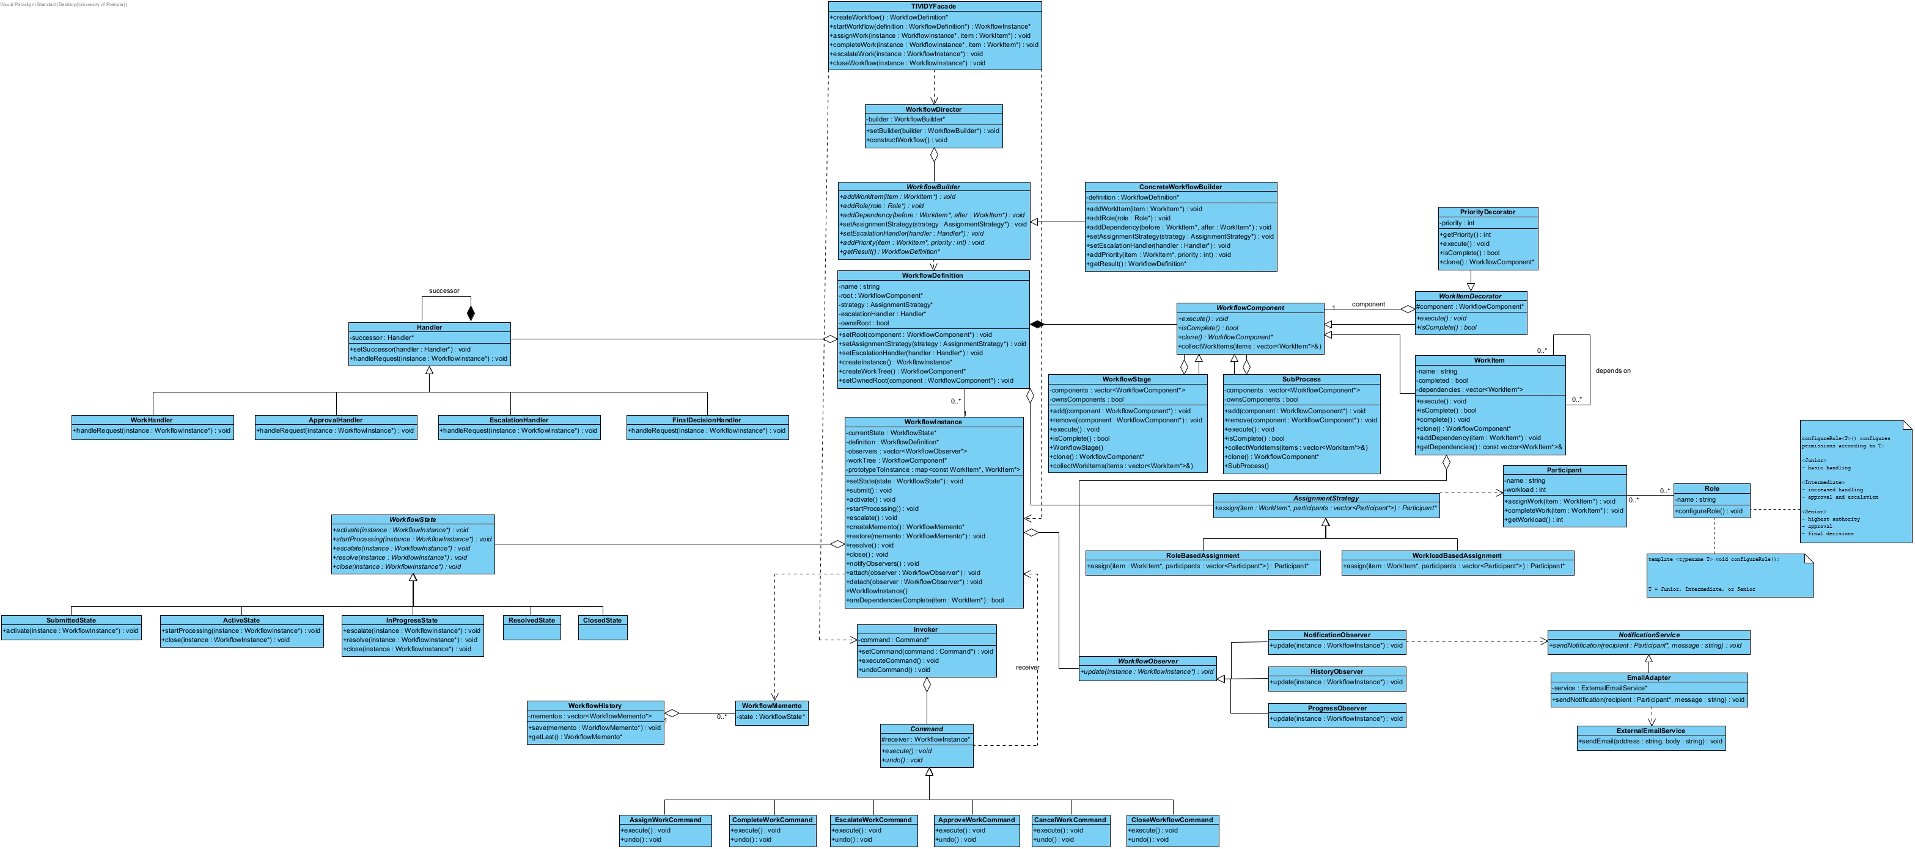
UML class diagram
APPENDIX
Notes:
Section time: Appendix: only if asked
The class diagram in the earlier deck is the old export. Re-export from the latest Visual Paradigm file (includes Prototype clone() and getState) before using it.

Slide 26
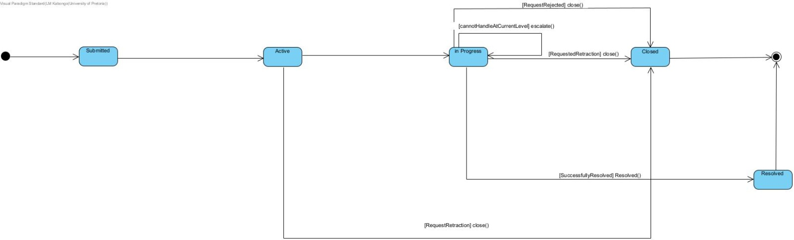
Life of a case
APPENDIX
Notes:
Section time: Appendix: only if asked
The state diagram in the earlier deck still shows an Escalated state. Re-export it with Escalated removed (escalation keeps the case In Progress) so it matches slide 4.

Slide 27
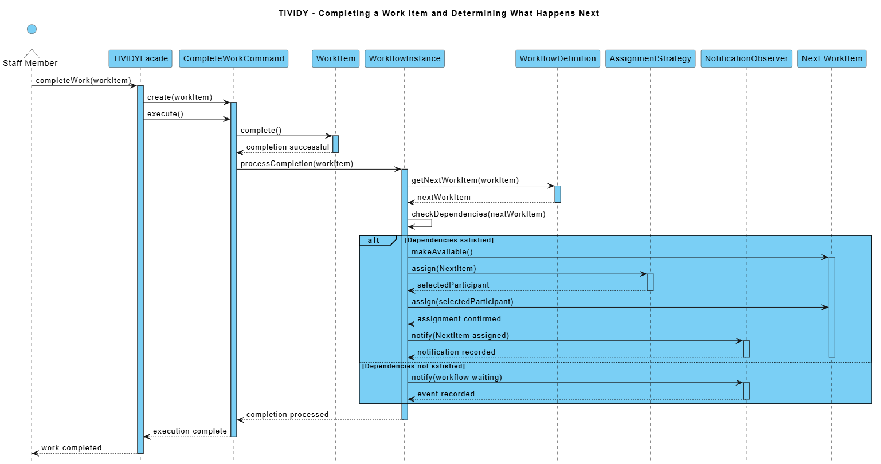
What happens when work is finished
APPENDIX · BOTH INDUSTRIES
When a task is done, the engine checks what was waiting on it. If everything needed is ready, the next task opens and its owner is told. If not, it waits.
Notes:
Section time: Appendix: only if asked
Sequence diagram: completing a work item and deciding what happens next.

Slide 28
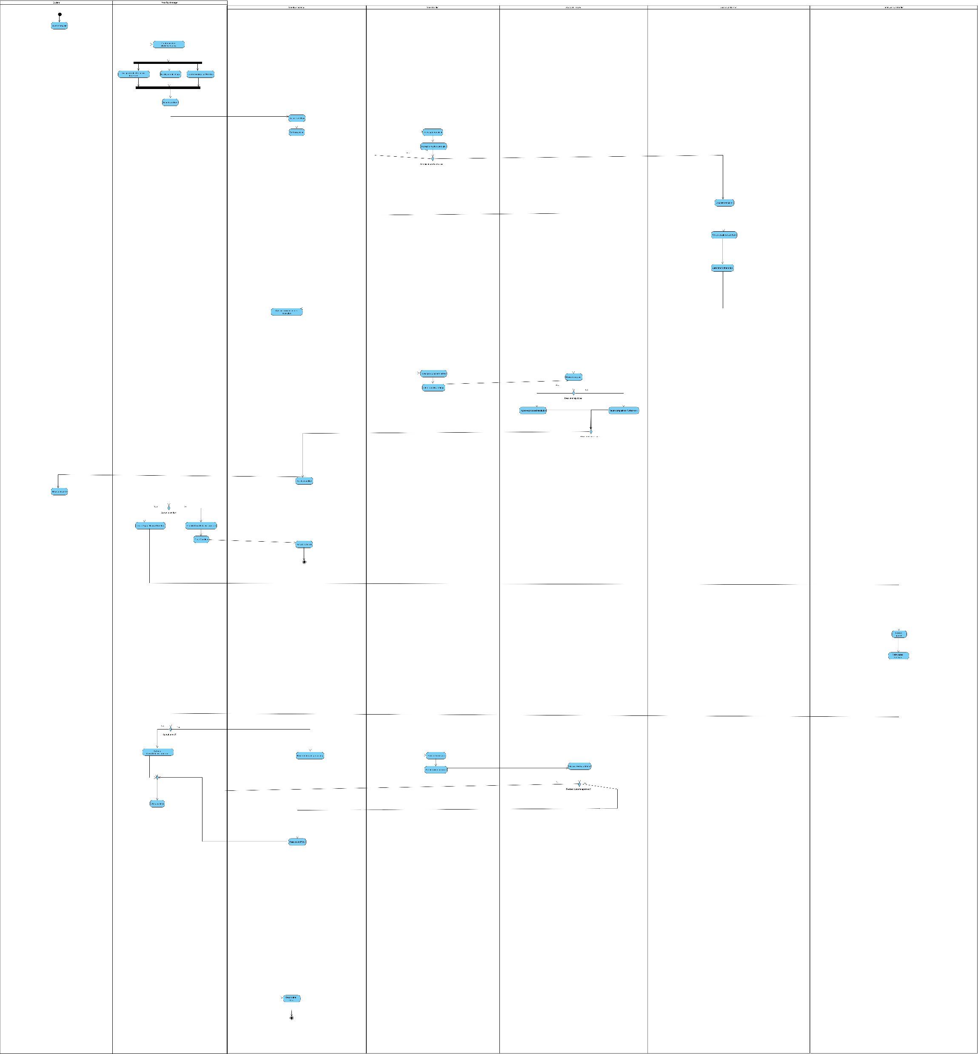
A complaint, step by step
APPENDIX · UNIVERSITY
A student sends in a complaint
It is checked and sent to the right department.
Staff look into it
If they can’t fix it, it moves up to the department head, then the faculty.
Every case ends clearly
Resolved if the student accepts, closed if they withdraw or an appeal is denied.
Notes:
Section time: Appendix: only if asked
Activity diagram for the university complaint workflow. The exported image is low resolution: re-export it larger (SVG or PDF) if the lane text is not readable.

Slide 29
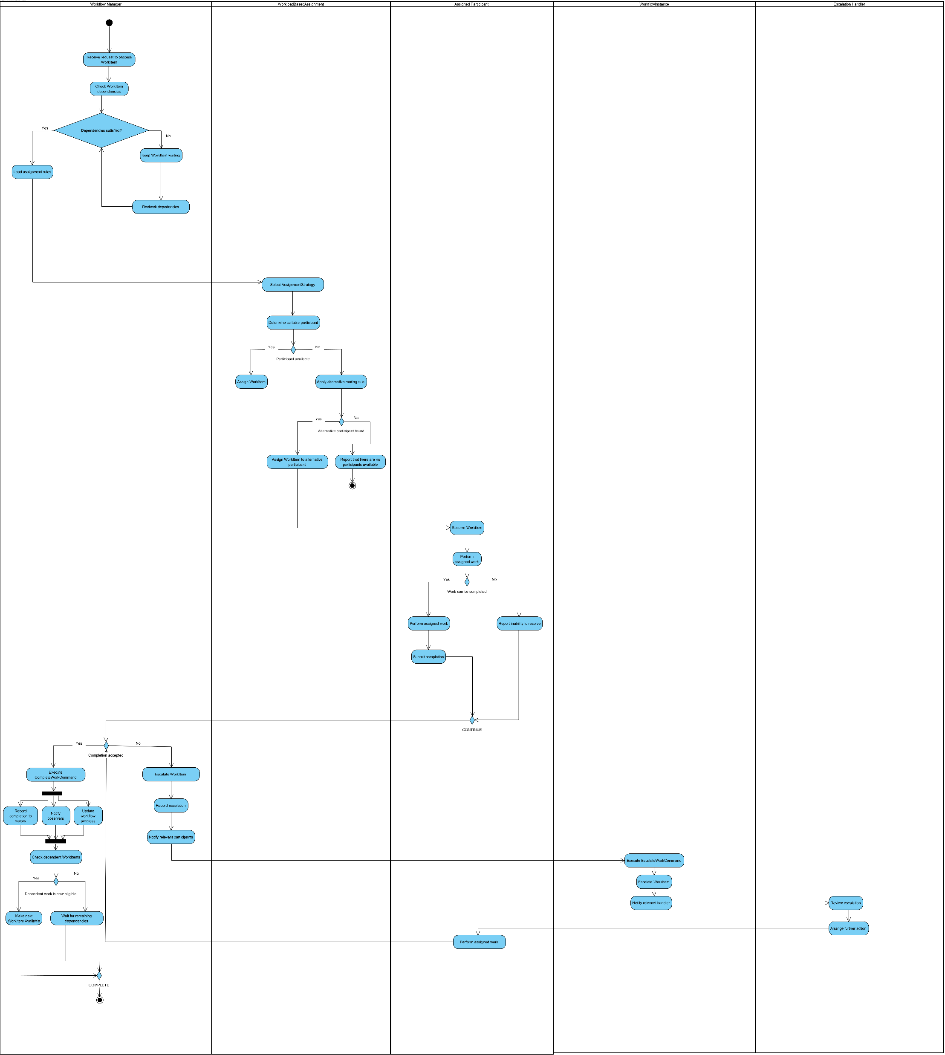

How work gets assigned and finished
APPENDIX · BOTH INDUSTRIES
Check first
A work item waits until the work it depends on is finished.
Find the right person
The engine picks who is free. If nobody is, it says so.
Finish or pass it up
Finished work updates progress and opens the next item. If it can’t be done, it goes up.
Notes:
Section time: Appendix: only if asked
Generic engine activity diagram: work assignment (workload based) and completion, including escalation. Used by both industries.

Slide 30
Requirements traceability
APPENDIX
Requirement | Design (classes and patterns) | Automated test
Independent workflow cases | WorkflowDefinition.createInstance(), clone() (Prototype) | WorkflowInstances created from one definition remain independent
Lifecycle and invalid transitions | WorkflowState hierarchy (State) | Lifecycle: a skipped step is rejected and nothing changes
Routing and assignment | AssignmentStrategy (Strategy) | Role-based assignment selects the first participant with the required role
Approval and escalation | Handler chain, EscalateWorkCommand | Configured escalation chain handles a workflow request
History and audit trail | WorkflowObserver, WorkflowHistory (Observer, Memento) | Workflow instances keep separate audit histories
External notification | NotificationService, EmailAdapter (Adapter) | EmailAdapter forwards notifications to ExternalEmailService
Nested work and priority | WorkflowComponent, PriorityDecorator (Composite, Decorator) | WorkflowStage can contain and track a PriorityDecorator
Notes:
Section time: Appendix: only if asked
Replace the bracketed test names with the real test cases from the suite.

Slide 31
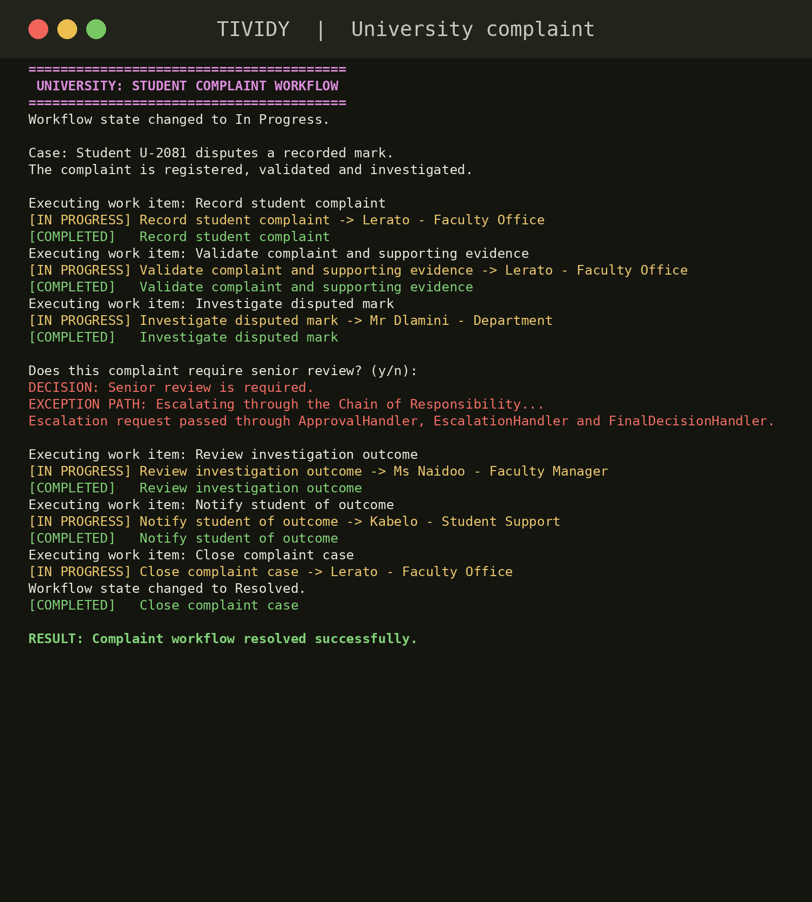
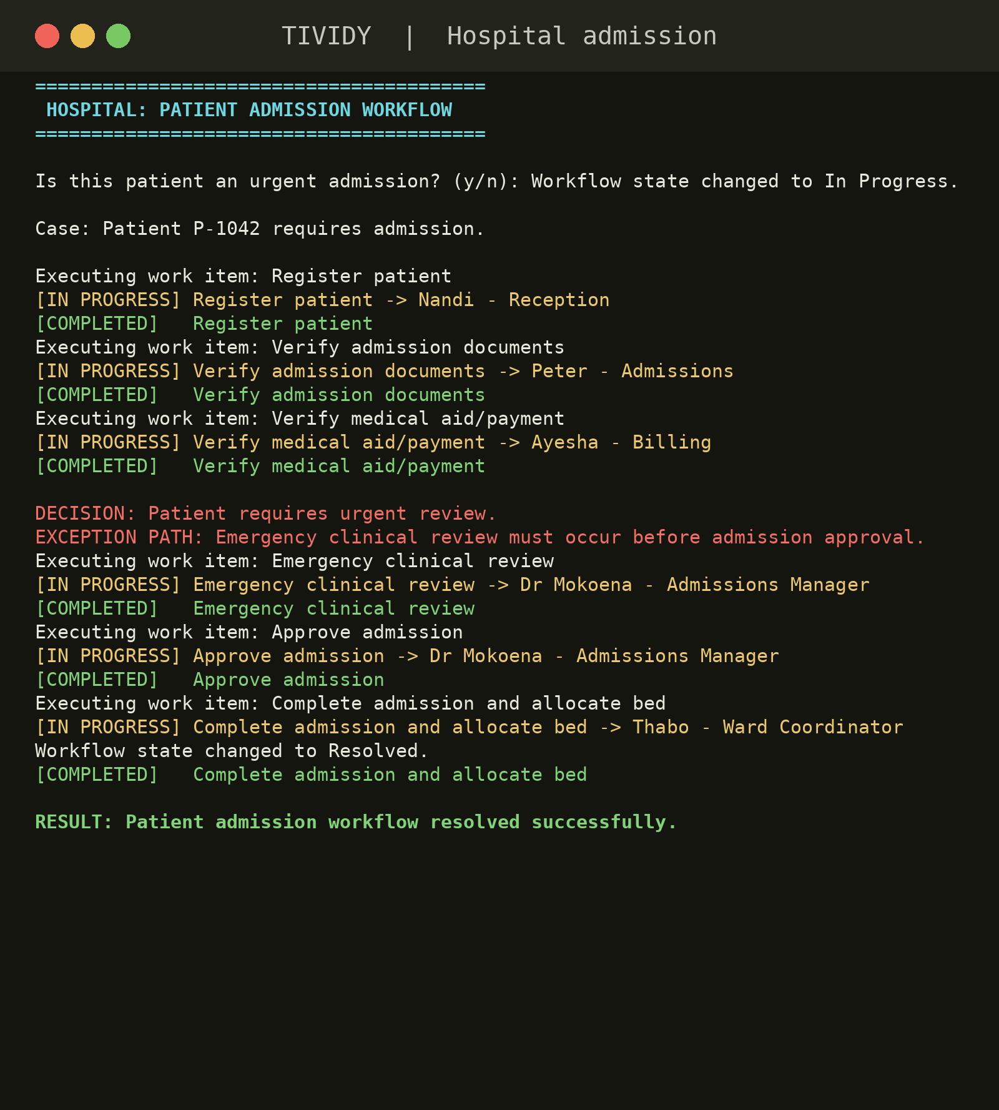
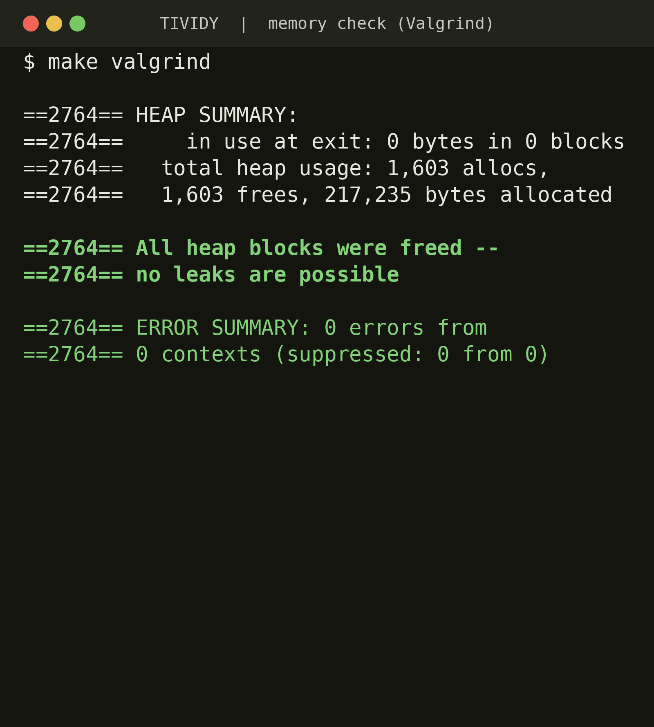
Backup screenshots
APPENDIX
TUI: University complaint run
TUI: Hospital admission run
Clean Valgrind output
Notes:
Section time: Appendix: only if asked
Emergency fallback only. A live system is required for the demo.

